Slide 1

Depression and suicide psychology
Capstone final project
Maickery Bozor
July 23, 2020

Slide 2
Introduction
Suicide is the deliberate act of ending one's own life, it’s a phenomenon that affects all regions of the world. More than 800,000 people per year die by committing suicide. These deaths can occur at any age in life. In the optic of help to decrease this quantity of suicides, Dr Christine Dupre would like to open a new psychologist’s office. She has the idea of settling somewhere where statistically there is the highest level of suicides in the world.
His counterparts will be interested
OMS will be interested

Slide 3
Data acquisition and cleaning
Worldwide suicide from Kaggle dataset https://www.kaggle.com/russellyates88/suicide-rates-overview-1985-to-2016
Population of USA:https://fr.wikipedia.org/wiki/%C3%89tats_des_%C3%89tats-Unis_par_population
City of California: https://fr.wikipedia.org/wiki/Liste_des_villes_de_Californie_par_population

Slide 4
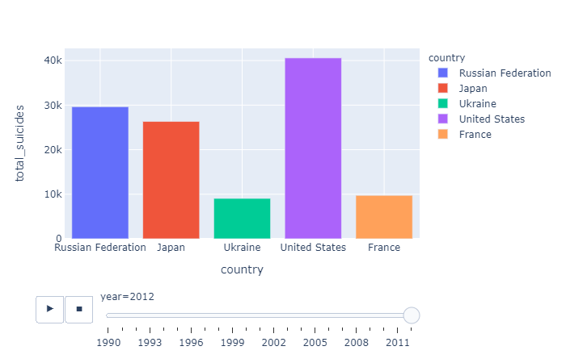
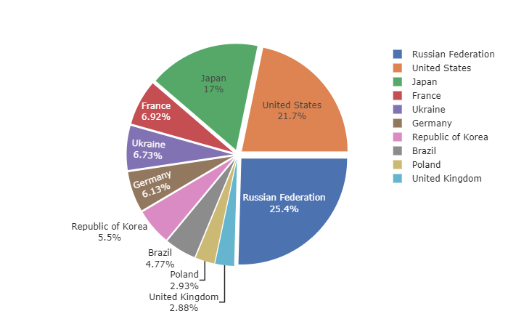
Russia VS USA for highest suicide rate

Slide 5
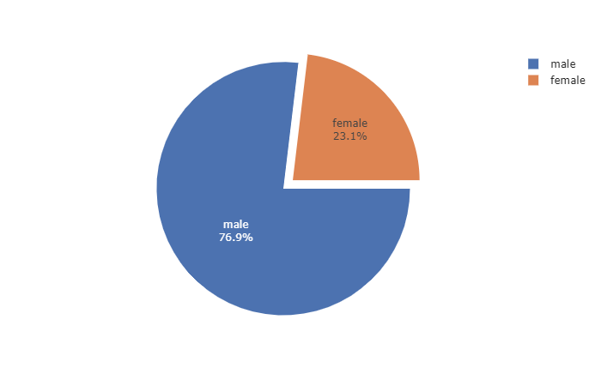
Male has the highest suicide rate
Whether in general or specifically in the United States, males have the highest level of suicide

Slide 6
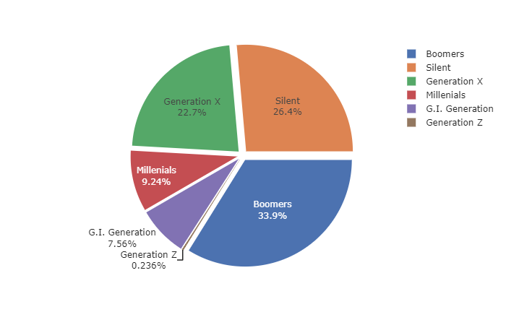
Baby Boomers(Born 1946-1964), the biggest
Baby boomers are the biggest when it comes to suicide

Slide 7
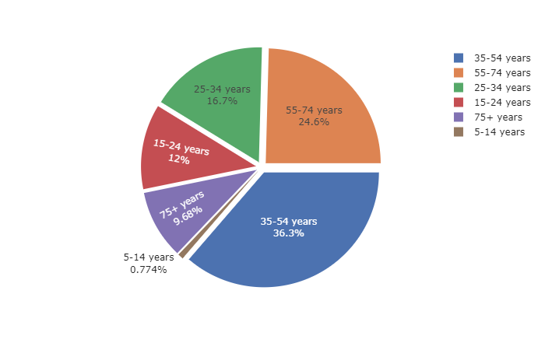
Most suicidal age group
People between the ages of 35-54 are most likely to commit suicide

Slide 8
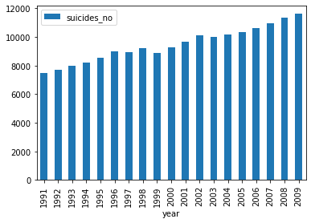
United states of America
Over the years the USA has overtaken Russia in terms of suicide rate. They are now the great power of suicide

Slide 9
Discussion
The exploratory of the suicide data from 1985 to 2015 let's us to conclude that: The highest suicide rate is recorded in the United States, specifically among men aged 35 to 54.
Based on the exploratory of the worldwide suicide data,factors that will influence our decission are:
country with the highest suicides rate . with highest male aged between 35-54
as few clinics near as possible
away from traffic noise

Slide 10
Conclusion and future directions
According to a research California have the highest population over all the states of USA, and Los Angeles have the highest level of population in California. Los Angeles is the second largest city in the United States in terms of population after New York. Located in the southern state of California on the Pacific coast, the city is the seat of Los Angeles County.
Los Angeles is the best destination for Dr Dupre to open his new clinic

